Slide 1
Credentials of Value
2024 Annual Trustees Conference
3.26.24
Tina Moore, Ed.D.
Director of Workforce Development
AR Division of Higher Education

Slide 2
Today we will…
Review purpose, goals, and progress of state CoV efforts
Discuss connections to the Governor’s Workforce Strategy
Explore existing definitions and criteria for
Credentials
High-wage
High-skill
High-demand

Slide 3
Purpose, Goals,
and Progress

Slide 4
LEARNS Executive Order
An analysis of the alignment of the programs, degrees and certificates, and industry-recognized credentials offered by Arkansas K-12, postsecondary, and workforce institutions;
An analysis of the alignment of these programs, degrees and certificates, and industry-recognized credentials with high-growth, high-demand, high-skill, and high-wage employment opportunities in Arkansas;
An evaluation of the outcomes of individuals who participate in or receive these programs, degrees and certificates, and industry-recognized credentials such as academic achievement, college readiness, postsecondary enrollment and completion, attainment of degrees, certificates, credentials of value, and employment and wages; and
An analysis of the return on investment of the programs, degrees and certificates, and industry-recognized credentials offered by Arkansas K-12, postsecondary, and workforce institutions.

Slide 5
LEARNS Act (SB294/Act237)
6-16-1803. Career-ready pathway requirements.
(a) A career-ready pathway to a diploma shall:
(1) Provide a student with credentials of value in a desired high-wage, high-growth career and a strong academic core;
(References: High-wage 6x. High-growth 5x. Credential 6x.)
https://www.arkleg.state.ar.us/Acts/FTPDocument?path=%2FACTS%2F2023R%2FPublic%2F&file=237.pdf&ddBienniumSession=2023%2F2023R

Slide 6
H. R. 6585 [Report No. 118–337] To amend the Higher Education Act of 1965 to extend Federal Pell Grant eligibility to certain short-term workforce programs.
(The program) provides an education aligned with the requirements of high-skill, high-wage (as identified by the State pursuant to section 122 of the Carl D. Perkins Career and Technical Education Act (20 U.S.C. 2342), or in-demand industry sectors or occupations.
(Multiple references to credentials)
https://www.congress.gov/118/bills/hr6585/BILLS-118hr6585rh.pdf

Slide 7
Perkins V
The Strengthening Career and Technical Education for the 21st Century Act (Perkins V) requires Perkins funded programs to prepare students for “high-skill, high-wage, or in-demand occupations.” The responsibility of defining these terms rests solely with states.
https://cte.ed.gov/legislation/perkins-v

Slide 8
Workforce and Innovation Act (WIOA)
Combined State Plan Draft 2024-2027
“Credential” or a form of the word is listed 143 times!

Slide 9
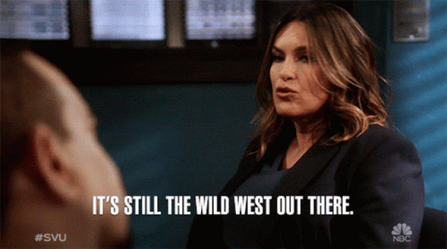

Slide 10
Credentials of Value
State Workgroup Goals
Define “credential”
Establish operational definition for high-wage, high-skill, high-demand (H3) credentials/occupations that takes into account existing requirements for WIOA and Perkins
Develop credential of value (CoV) criteria and metrics
including but not limited to H3, allowing for credentials that may not fully meet set H3 thresholds but are part of sequence of credentials that do
utilizing primary and secondary, traditional and real-time data sources
Engage education and workforce stakeholders across sectors to develop criteria and review credentials
Develop credential review process and timeline

Slide 11
Education and workforce stakeholders across sectors
Government agencies
State licensing boards
Higher education
Business and industry
Workforce Development Boards
Workforce councils
State and local chambers
Subject matter experts
Private career education providers
Relevant associations and nonprofits

Slide 12
Outline of CoV Work Milestones to Date
Task | Oct 23 | Nov 23 | Dec 23 | Jan 24 |  | Feb 24 |  | Mar 24
Research existing landscape in AR and CoV/H3 work nationally
Internal State Agency Staff Initial Meeting (11.17.23)
Review and analyze feedback
CoV Workgroup Initial Meeting (1.19.24)
Review and analyze feedback
CoV Workgroup Meeting (2.9.24)
Review and analyze feedback
Internal State Agency Staff Meeting (3.15.24)
Collaboration with other states on their CoV process and methodology

Slide 13
Connections to the
Governor’s Workforce Strategy

Slide 14
Executive Order to Create the Governor’s
Workforce Cabinet & Chief Workforce Officer
Arkansans must have the skills to compete for employment in the current job market
In Arkansas, approximately six out of ten jobs require credentials beyond a high school diploma, however, less than half of the workforce in Arkansas is credentialed beyond a high school diploma
Currently, there are six state agencies in Arkansas state government that provide or coordinate career and technical education and workforce development
It is the policy of this Administration to create a single entity to coordinate and to assist in career and technical education, which in turn, will ensure that young adults who are entering the workforce are prepared for high-wage, high-growth careers
https://governor.arkansas.gov/executive_orders/executive-order-to-create-the-governors-workforce-cabinet-and-the-chief-workforce-officer/

Slide 15
Governor’s Workforce Strategy
Recommendation #2:
The Arkansas Department of Education (ADE), in partnership with the Department of Transformation and Shared Services (TSS), should lead the alignment of training and career pathways to ensure students learn applicable skills and competencies.
Identify which skills are most important to Arkansas employers and reward meaningful credentials, i.e., certificates, diplomas, degrees, that align with the needs of job seekers, educators, and employers.
Improve the public school accountability system to reward schools for providing real-world skills through high demand industry certifications.
Effectively market non-traditional postsecondary paths.
Realign the higher education funding formula to enhance the value of providing training that leads to gainful employment.
https://governor.arkansas.gov/arkansas-workforce-strategy/

Slide 16
What are considered “credentials”?

Slide 17
ADHE
Credential Definition
Credentials include all credit-bearing credentials as recognized by the Arkansas Division of Higher Education. This includes Basic Certificates, Technical Certificates, Vocational Diplomas, Associate Degrees, Advanced Certificates, Baccalaureate Degrees, Post-Baccalaureate Degrees, Master’s Degrees, Post-Master/Specialist Degrees, and Doctoral Degrees. Not included are non-credit credentials even if that non-credit credential results in eligibility for a state or nationally recognized license or certification.

Slide 18
WIOA
Credential Definition
RECOGNIZED POSTSECONDARY CREDENTIAL.—The term ‘‘recognized postsecondary credential’’ means a credential consisting of an industry-recognized certificate or certification, a certificate of completion of an apprenticeship, a license recognized by the State involved or Federal Government, or an associate or baccalaureate degree.

Slide 19
AR Perkins Plan
Credential Definition
Recognized Postsecondary Credential. Perkins V adopts the definition included in WIOA which includes: a college award (CP, TC, AAS), industry-recognized certification, apprenticeship certification, or state/federal recognized license.

Slide 20
National Skills Coalition
Credential Definition
A non-degree credential (NDC) is any postsecondary credential beyond a high school diploma (or its equivalent) that falls outside of the parameters of a degree program. NDCs can vary in programmatic length, credits earned, and postsecondary provider. NDC generally include the following categories:
Certificates
Industry Certifications
Apprenticeship Certificates
Occupational Licenses
Badges and Microcredentials

Slide 21
Credential Engine
Credential Definition
“A qualification, achievement, personal or organizational quality, or aspect of an identity typically used to indicate suitability.”
Credential: diplomas, badges, certificates, apprenticeships, licenses, certifications and degrees of all types and levels that represent unique competencies that signal what a holder can do in the workforce.

Slide 22
Stackable Credential
A credential is considered stackable when it is part of a sequence of industry-recognized credentials that can be accumulated over time to demonstrate an individual’s expanded knowledge and competencies, help him or her advance within a career pathway, and enable the learner to earn family-sustaining wages.
https://cte.ed.gov/initiatives/stackable-credentials-tool-kit

Slide 23
While a career pathway is designed to enable an individual to continue along predetermined educational sequences to achieve higher-level skills and competencies in an occupation or field, stackable credentials represent milestones along the pathway that provide validation to employers of an individual’s mastery of specific competencies.
Because these credentials provide evidence of skill attainment in areas aligned to industry needs, stackable credentials enable adult learners to pause their participation in a pathway while still realizing educational value and employment opportunity for the portion of the pathway that they completed.
https://cte.ed.gov/initiatives/stackable-credentials-tool-kit

Slide 24
Stackable Certificates and Degrees
Example: UA Little Rock Cybersecurity
Prior Learning Credit: WBL, apprenticeships/internships, military, OTJ, bootcamps
CP 1
CP 2
“Byte-Sized” Certificates:
Multiple, Flexible Pathways
Technical Certificate
Associates Degree
Bachelors Degree
Graduate Degree

Slide 25
You have an OSHA 10 certification?
YOU ARE HIRED!
We will even pay you $1 more per hour!

Slide 26
This underwater basket weaving degree is really going to pay off!

Slide 27
H3 definitions vary across agencies.
High-Wage
High-Skill
High-Demand

Slide 28
ADHE
High-Demand
High-Wage
High Demand (Targeted Credentials): Targeted credentials are simply degrees where there is higher-than-average demand in the job market, as well as a gap between the market demand and the number of graduates.
High Wage: Programs of study that have an average wage greater than the average across all credentials.

Slide 29
AR Perkins V
High-Wage
High-Skill
High-Demand
High-wage occupation - an average hourly rate equal to or greater than the average hourly rate of all similar occupations as reported by the Arkansas Department of Labor.
High-skill occupation - occupations that require an industry-credential of value, postsecondary training, apprenticeship, or degree.
In-demand occupation - an industry sector that has a substantial current or potential impact (including through jobs that lead to economic self-sufficiency and opportunities for advancement) on the state, regional, or local economy, as appropriate, and that contributes to the growth or stability of other supporting businesses, or the growth of other industry sectors.

Slide 30
Recent AR CTE Audit
High-Wage
High-Skill
High-Demand
High-wage: Average hourly wage greater than the Arkansas median wage.
High-Skill: Occupations that require an industry-credential of value, postsecondary training, apprenticeship, or degree.
High-Demand: A high-priority industry sector that has a substantial current or potential future impact on the state economy.

Slide 31
WIOA
High-Wage
High-Skill
High Wage and High Skill are both universally mentioned but not explicitly defined.
High wage may be comparable to “self-sufficiency” in the WIOA world.
Local Workforce Development Boards are required to write their own definitions for eligibility and policy purposes.

Slide 32
Current Local Area Workforce Board WIOA Self-Sufficiency Standard Definitions
Central=only eligibility definition: falls within the poverty level or the LLSIL
Little Rock=185% of LLSIL or 90% wages prior to layoff
Eastern Arkansas=200% Poverty Level or 90% wages prior to layoff
Southeast=150% of LLSIL or 90% wages prior to layoff
Southwest=185% LLSIL
NWAEDD=250% Poverty Level
NorthCentral=175% LLSIL
NEAWDB=160% of LLSIL or 90% of wages prior to layoff
Western=200% of LLSIL based on family size
West Central=uses Living Wage Calculator, roughly 250% of LLSIL
Data compiled by Dr. Jake Walker, TSS

Slide 33
WIOA
High-Demand
In-demand industry sector or occupation – One of the following [WIOA § 3(23)(A)]
A. An industry sector that has a substantial current or potential impact (including through jobs that lead to economic self-sufficiency and opportunities for advancement) on the state, regional, or local economy, as appropriate, and that contributes to the growth or stability of other supporting businesses or the growth of other industry sectors
B. An occupation that currently has or is projected to have a number of positions (including positions that lead to economic self-sufficiency and opportunities for advancement) in an industry sector so as to have a significant impact on the state, regional, or local economy, as appropriate.
The determination of whether an industry sector or occupation is in-demand is made by the AWDB or LWDB, as appropriate, using state and regional business and labor market projections, including the use of labor market information [WIOA §3(23)(B)].

Slide 34
DWS
High-Skill
High Skill: Requires Doctoral or professional, Master’s, or Bachelor’s Degree
Moderate Skill: Requires Associate degree, Postsecondary non-degree award, or some college but no degree
Low Skill: High School diploma or equivalent, No Formal Education

Slide 36
CIP, SOC, and NAICS Codes
CIP- Classification of Instructional Programs
SOC- Standard Occupational Classification
NAICS- North American Industry Classification System

Slide 37
CIP SOC Crosswalk
A joint effort by the Bureau of Labor Statistics and the National Center for Education Statistics
Matches 6-digit CIP Codes from the 2020 CIP with 6-digit detailed descriptions from the 2018 SOC.
Purpose is to match postsecondary programs of study that provide graduates with specific skills and knowledge to occupations requiring those skills or knowledge to be successful.
https://nces.ed.gov/ipeds/cipcode/post3.aspx?y=56
https://www.bls.gov/oes/current/naics3_611000.htm#:~:text=NAICS%20611000%20%2D%20Educational%20Services%20is,%3A%20Sector%2061%20%2D%20Educational%20Services.&text=SOC%20Major%20Groups%20in%20NAICS,00%2D0000%20All%20Occupations

Slide 38
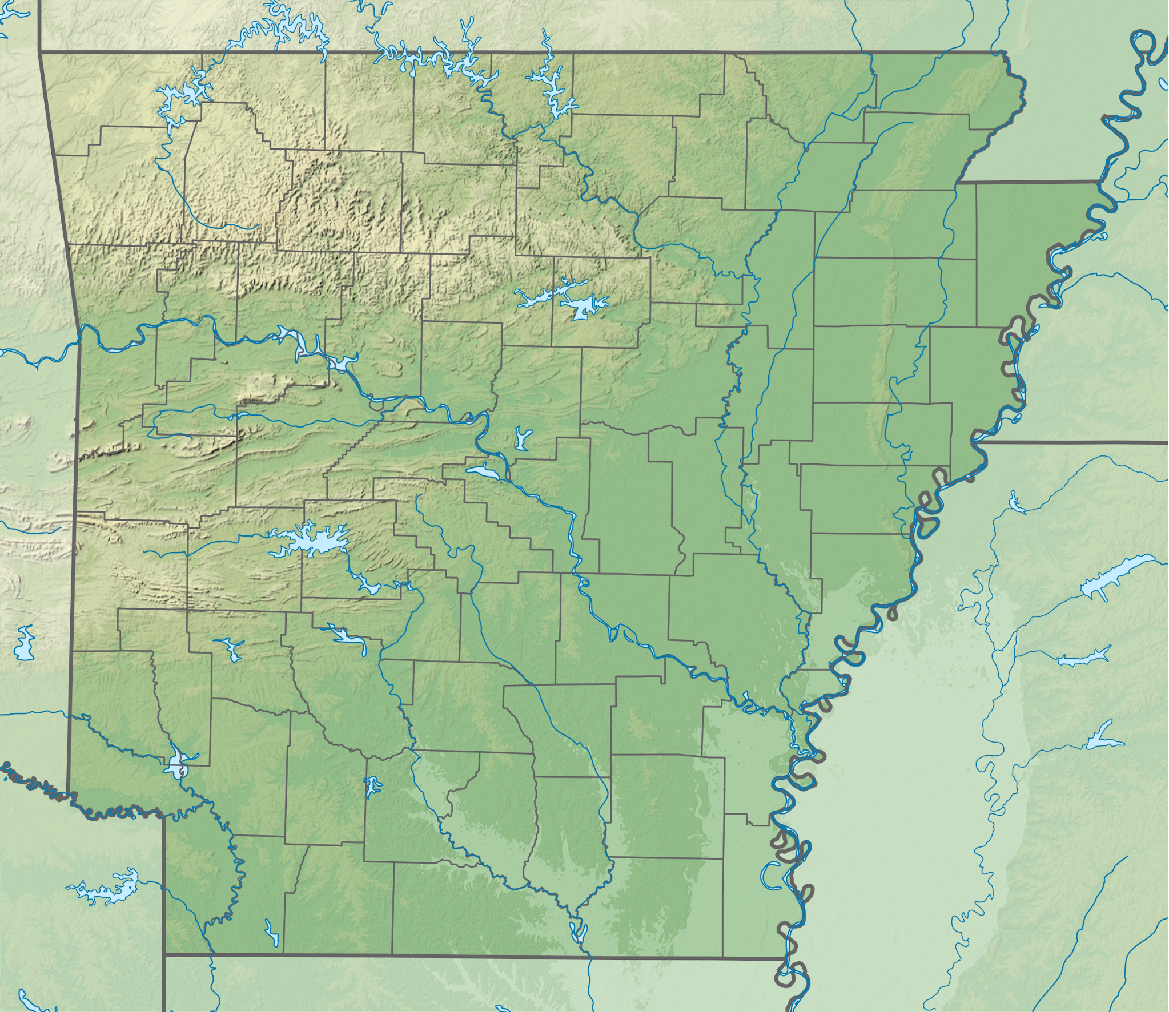

Slide 39
Credential of Value Examples
From Other States
Alabama
Florida
Hawaii
Indiana
Texas
CoV must meet a certain cost-benefit threshold
A typical student with that credential must earn enough within 10 years to pay for the cost of their education and surpass the earnings of a typical high school graduate

Slide 40
Credentials of Value Additional Resources and Information
tina.moore@adhe.edu
linkedin.com/in/tina-moore-4a1314181

